Slide 1
Leveraging Amazon Product Ratings for Performance Analysis
Presented By Group 8: Rushma Parajuli, Vineeth Kumar Shambuni, Rohan Sanjay Singh, Shivani Sodagum

Slide 2
Dataset Selected: Amazon Sales Dataset
Why did we select this data?
Diversity
Large Sample Size
Rating System
User Reviews
Real-world Application
Where are you getting this data from?
Dataset Source: Kaggle - Amazon Sales Dataset
Structure
Size: Our dataset has 1400 rows and 9 columns.
Variables:
discounted_price
actual_price
discount_percentage
rating
rating_count
rating_decision
discount_decision

Slide 3
Research Questions
Classifying Products by Rating: Can we classify products into high and low-rated categories based on their features like discounted price, actual price, rating and discount percentage?
Predicting Product Sales: Can we predict the number of sales for a product based on its, discounted price, actual price, discount percentage and rating?

Slide 4
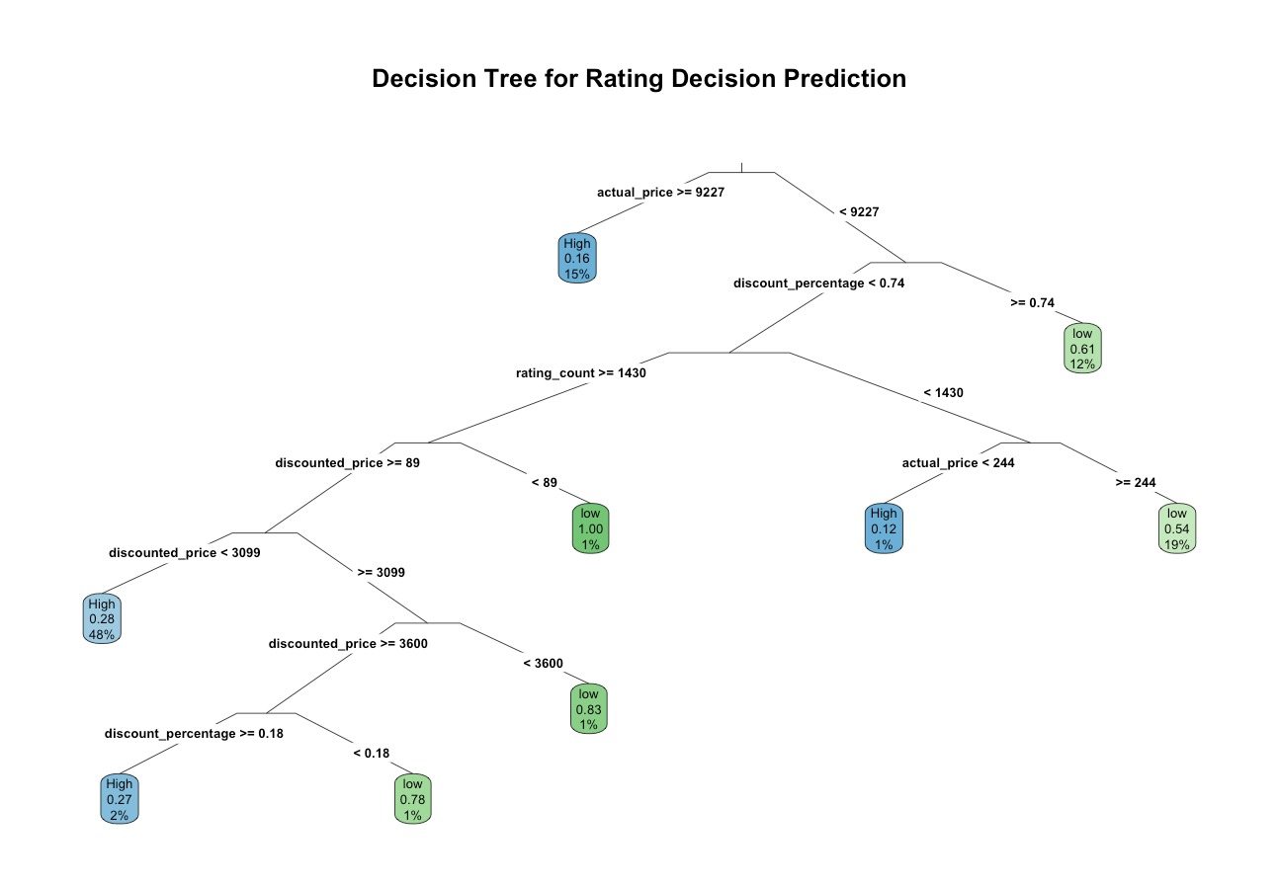

Slide 5
Conduct Analysis
Training parameters
model <- rpart(rating_decision ~ discounted_price + actual_price + discount_percentage+rating_count, data = trainData)

Slide 6
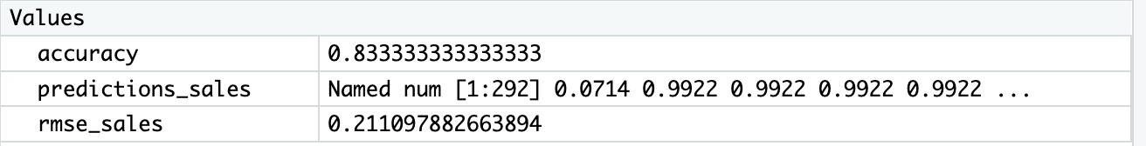
Testing
Classifying Products by Rating

Slide 7
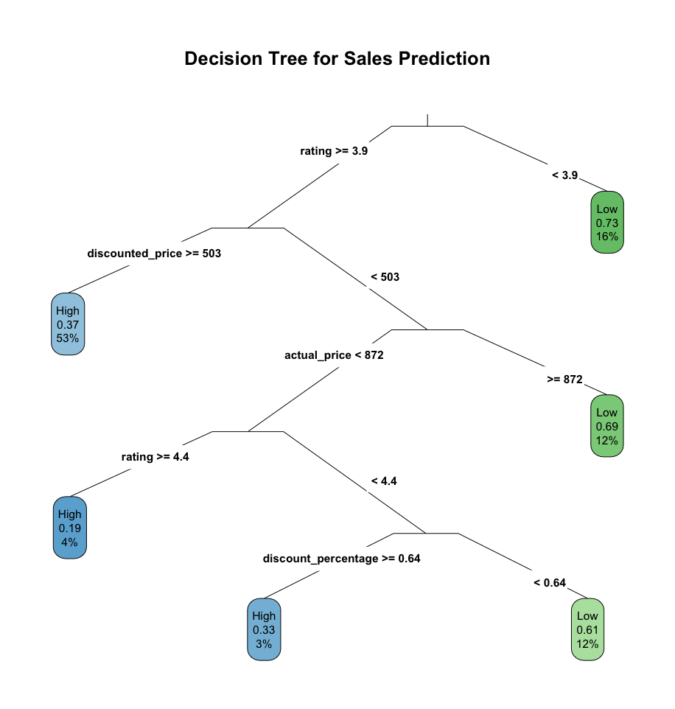

Slide 8
Conduct Analysis
Training parameters
2. model <- rpart(sales_decision ~ discounted_price + rating + actual_price + discount_percentage, data = trainData)

Slide 9
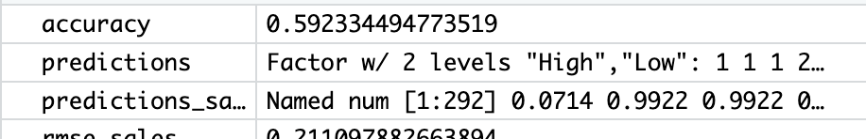
Testing
2. Classifying Products by Discount Percentage:

Slide 10
Questions?

